Slide 1
Partitioning the User Interface with Fragments

Slide 2
Overview
Understand what fragments are and how to use them
Learn about the requirements for making fragments work on applications prior to Android 3.0 (API Level 11)
Introduce the concept of nested fragments

Slide 3
Understanding Fragments
By incorporating Fragment components into your user interface design, you write one application that can be tailored to different screen characteristics and orientations instead of different applications tailored to different types of devices
This greatly improves code reuse, simplifies application testing needs, and makes publication and application package management much less cumbersome
Notes:
Fragments were added to the Android SDK at a crucial time when Android consumers were experiencing an explosion in the variety of Android devices coming to market.
We now see not just smartphones but other larger-screen devices such as tablets and televisions that run the platform.
These larger devices come with substantially more screen real estate for developers to take advantage of.
The typical streamlined and elegant smartphone user interface often looks oversimplified on a tablet.

Slide 4
Understanding Fragments
The basic rule of thumb for developing Android applications used to be to have one Activity per screen of an application
This ties the underlying “task” functionality of an Activity class very directly to the user interface
However, as bigger devices are now available, this technique faces some issues
Previously, when you had more room on a single screen to do more, you had to implement separate Activity classes, with very similar functionality, to handle the cases where you wanted to provide more functionality on a given screen
Fragments help manage this problem by encapsulating screen functionality into reusable components that can be mixed and matched within Activity classes

Slide 5
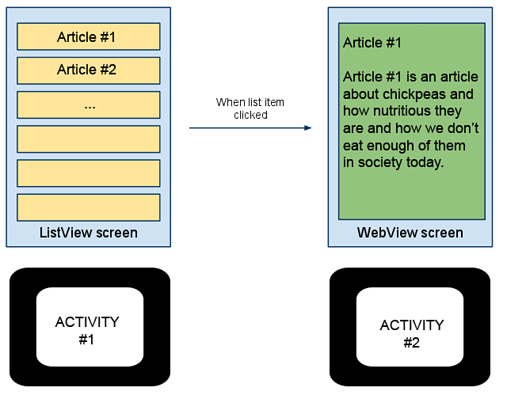
Understanding Fragments
Notes:
Let’s look at a theoretical example. Let’s say you have a traditional smartphone application with two screens. Perhaps it’s an online news journal application. The first screen contains a ListActivity with a ListView control. Each item in the ListView represents an article available from the journal that you might want to read. When you click a specific article, since this is an online news journal application, you are sent to a new screen that displays the article contents in a WebView control.
This workflow works fine for small-screen smartphones, but it’s a waste of all the space on a tablet or a television. Here, you might want to be able to peruse the article list and preview or read the article on the same screen. If we organize the ListView and the WebView screen functionality into two standalone Fragment components, we can easily create a layout that includes both on the same screen when screen real estate allows.

Slide 6
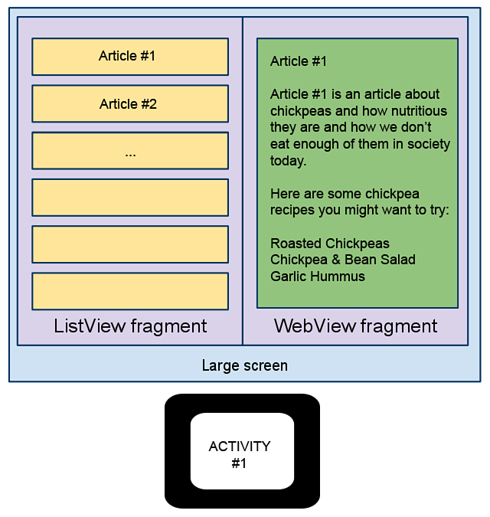
Understanding Fragments
Notes:
Here is our improved screen workflow with fragments.

Slide 7
Understanding the Fragment Lifecycle
A Fragment must be hosted within an Activity class
It has its own lifecycle, but it is not a standalone component that can exist outside the context of an Activity
The responsibilities of Activity class management are greatly simplified when the entire user interface state is moved off into individual fragments
Activity classes with only fragments in their layouts no longer need to spend a lot of time saving and restoring their state because the Activity object now keeps track of any Fragment that is currently attached automatically
The Fragment components themselves keep track of their own state using their own lifecycle
Naturally, you can mix fragments with View controls directly in an Activity class
The Activity class will be responsible for managing the View controls, as normal

Slide 8
Understanding the Fragment Lifecycle
Instead, the Activity must focus on managing its Fragment classes
Coordination between an Activity and its Fragment components is facilitated by the FragmentManager
  android.app.FragmentManager
The FragmentManager is acquired from the getFragmentManager() method, which is available within the Activity and Fragment classes

Slide 9
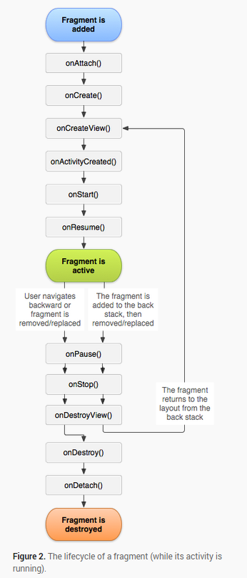
Lifecycle of Fragment

Slide 10
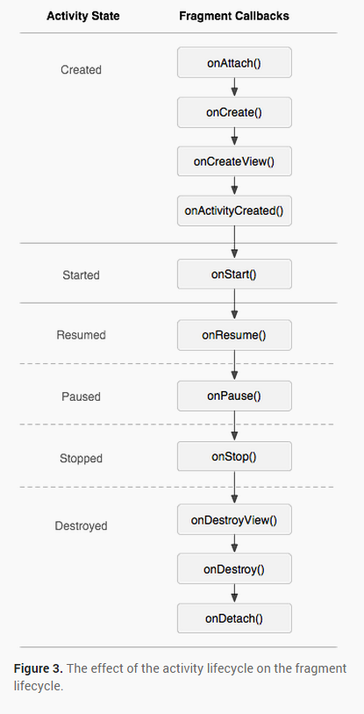
Activity Life Cycle on Fragment Lifecycle

Slide 11
Creating a Fragment
Some basic methods for fragment:
onCreate()
Within your implementation, you should initialize essential components of the fragment that you want to retain when the fragment is paused or stopped, then resumed.
onCreateView()
The system calls this when it's time for the fragment to draw its user interface for the first time. To draw a UI for your fragment, you must return a View from this method that is the root of your fragment's layout. You can return null if the fragment does not provide a UI.

Slide 12
Creating a Fragment
onPause()
The system calls this method as the first indication that the user is leaving the fragment (though it does not always mean the fragment is being destroyed). This is usually where you should commit any changes that should be persisted beyond the current user session (because the user might not come back).

Slide 13
Defining Fragments
Fragment implementations that have been defined as regular classes within your application can be added to your layout resource files by using the <fragment> XML tag and then loaded into your Activity using the standard setContentView() method, which is normally called in the onCreate() method of your Activity

Slide 14
Defining Fragments
  <fragment
  android:name=
  "com.androidintro.simplefragments.FieldNoteListFragment"
  android:id="@+id/list"
  android:layout_width="match_parent"
  android:layout_height="match_parent" />
Notes:
Here’s a simple example of a <fragment> layout reference that refers to a class called FieldNoteListFragment, which is defined as a .java class in the package.
When you reference a Fragment class that you have defined in your application package in an XML layout file, use the <fragment> tag. This tag has a few important attributes. Specifically, you will need to set the android:name attribute of the Fragment to the fully qualified Fragment class name. You will also need to give the item a unique identifier using the android:id attribute so that you can access that component programmatically, if needed. You still need to set the component’s layout_weight and layout_height attributes as you would for any other control in your layout.

Slide 15
Managing Fragment Modifications
When you have multiple Fragment components on a single screen, within a single Activity, you often have user interaction on one Fragment (such as our news ListView Fragment) causing the Activity to update another Fragment (such as our article WebView Fragment)
An update or modification to a Fragment is performed using a FragmentTransaction
  android.app.FragmentTransaction
A number of different actions can be applied to a Fragment using a FragmentTransaction operation, such as the following:
  A Fragment can be attached or reattached to the parent Activity
  A Fragment can be hidden and unhidden from view

Slide 16
Managing Fragment Modifications
Perhaps you are wondering how the Back button fits into the Fragment-based user interface design
We know the parent Activity class has its own back stack
As the developer, you can decide which FragmentTransaction operations are worth storing in the back stack and which are not by using the addToBackStack() method of the FragmentTransaction object
In our news application example, we might want each of the articles displayed in the WebView Fragment to be added to the parent Activity class’s back stack so that if the user hits the Back button, he or she traverses the articles already read before backing out of the Activity entirely

Slide 17
Attaching and Detaching Fragments with Activities
After you have a Fragment that you want to include within your Activity class, the lifecycle of the Fragment comes into play.
The following callback methods are important to managing the lifecycle of a Fragment, as it is created and then destroyed when it is no longer used
  onAttach()
  onCreate()
  onCreateView()
  onActivityCreated()
  onStart()
  onResume()
  onPause()
  onStop()
  onDestroyView()
  onDestroy()
  onDetach()
Notes:
The onAttach() callback method is called when a Fragment is first attached to a specific Activity class.
The onCreate() callback method is called when a Fragment is first being created.
The onCreateView() callback method is called when the user interface layout, or View hierarchy, associated with the Fragment should be created.
The onActivityCreated() callback method will inform the Fragment when its parent Activity class’s onCreate() method has completed.
The onStart() callback method is called when the Fragment’s user interface becomes visible but is not yet active.
The onResume() callback method makes the Fragment’s user interface active for interaction after the Activity has resumed or the Fragment was updated using a FragmentTransaction.
The onPause() callback method is called when the parent Activity is paused, or the Fragment is being updated by a FragmentTransaction. It indicates that the Fragment is no longer active or in the foreground.
The onStop() callback method is called when the parent Activity is stopped, or the Fragment is being updated by a FragmentTransaction. It indicates the Fragment is no longer visible.
The onDestroyView() callback method is called to clean up any user interface layout, or View hierarchy resources, associated with the Fragment.
The onDestroy() callback method is called to clean up any other resources associated with the Fragment.
The onDetach() callback method is called just before the Fragment is detached from the Activity class.

Slide 18
Working with Special Types of Fragments
There are some specialty Fragment classes you’ll want to familiarize yourself with, include the following:
  ListFragment (android.app.ListFragment)
  PreferenceFragment (android.preference.PreferenceFragment)
  WebViewFragment (android.webkit.WebViewFragment)
  DialogFragment (android.app.DialogFragment)
Notes:
ListFragment
Much like a ListActivity, this Fragment class hosts a ListView control.
PreferenceFragment
Much like a PreferenceActivity, this Fragment class lets you easily manage user preferences.
WebViewFragment
This type of Fragment hosts a WebView control to easily render Web content. Your application will still need the android.permission.INTERNET permission to access the Internet.
DialogFragment
Decoupling user interface functionality from your Activity classes means you won’t want your dialogs managed by the Activity either. Instead, you can use this class to host and manage Dialog controls as fragments. Dialogs can be traditional pop-ups or embedded.

Slide 19
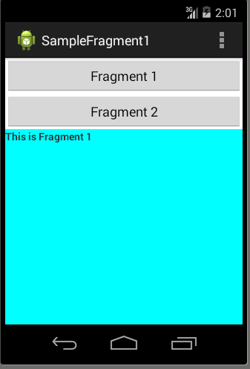
Designing Fragment-Based Applications
Notes:
Here is the sample application provided with this chapter. The application uses a ListFragment for the list of animals, as seen on the left, and a WebViewFragment to display each blog post describing an animal, as seen on the right. In portrait mode, we will display one Fragment per screen, requiring two Activity classes.

Slide 20
Implementing a Fragment
  public class FragmentOne extends Fragment
  {
  public View onCreateView(LayoutInflater inflater,ViewGroup container, Bundle savedInstanceState)
  {
  //Inflate the layout for this fragment
  return inflater.inflate(R.layout.fragment_one, container, false);
  }
  }
Notes:
Here we begin by defining a custom ListFragment class called FieldNoteListFragment to host our wild animal names. This class will need to determine whether the second Fragment, the FieldNoteWebViewFragment, should be loaded or if ListView clicks should simply cause the FieldNoteViewActivity to be launched.

Slide 21
Implementing a Fragment
public class FragmentTwo extends Fragment
{
public View onCreateView(LayoutInflater inflater,ViewGroup container, Bundle savedInstanceState)
{
//Inflate the layout for this fragment
return inflater.inflate(R.layout.fragment_two, container, false);
}
}
Notes:
Most of the Fragment control’s initialization happens in the onActivityCreated() callback method so that we initialize the ListView only once. We then check to see which display mode we want to be in by checking to see if our second component is defined in the layout.

Slide 22
Implementing a Fragment
public class MainActivity extends Activity {
@Override
protected void onCreate(Bundle savedInstanceState) {
super.onCreate(savedInstanceState);
setContentView(R.layout.activity_main);
}
public void selectFrag(View view)
{
Fragment fr;
if(view == findViewById(R.id.button2))
{
fr = new FragmentTwo();
}else
{
fr = new FragmentOne();
}
FragmentManager fm = getFragmentManager();
FragmentTransaction fragmentTransaction = fm.beginTransaction();
fragmentTransaction.replace(R.id.fragment_place, fr);
fragmentTransaction.commit();
}
Notes:
We leave the display details to the helper method called viewAnimalInfo(), which is also called whenever an item in the ListView control is clicked.
The logic for the viewAnimalInfo() method takes into account both display modes. If the device is in portrait mode, the FieldNoteViewActivity is launched via an Intent. However, if the device is in landscape mode, we have some Fragment finagling to do.
Specifically, the FragmentManager is used to find the existing FieldNoteWebViewFragment by its unique identifier (R.id.fieldentry, as defined in the layout resource file). Then, a new FieldNoteWebViewFragment instance is created for the new animal blog post being requested. Next, a FragmentTransaction is started, in which the existing FieldNoteWebViewFragment is replaced with the new one. We put the old one on the back stack so that the Back button works nicely, set the transition animation to fade between the blog entries, and commit the transaction, thus causing the screen to update asynchronously.

Slide 23
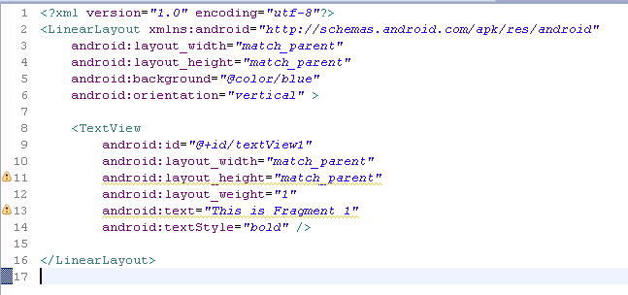
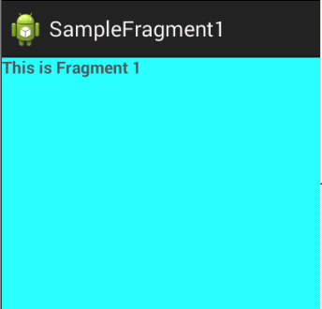
Implementing a Fragment

Slide 24
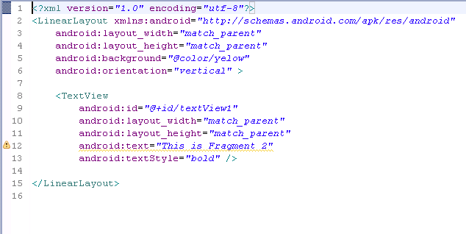
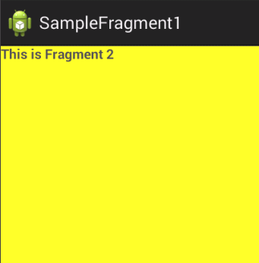
Implementing a ListFragment
Notes:
Finally, we can monitor the back stack with a call to the addOnBackStackChangedListener() method. The callback, onBackStackChanged(), updates the list to the current selected item. This provides a robust way to keep the ListView item selection synchronized with the currently displayed Fragment both when adding a new Fragment to the back stack and when removing one, such as when the user presses the Back button.

Slide 25
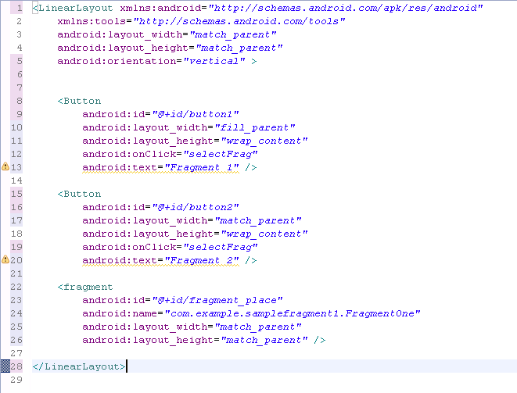
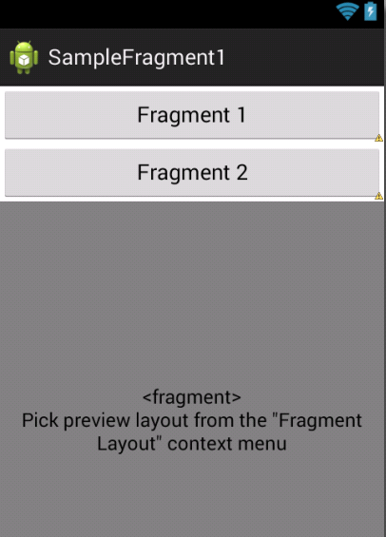
Implementing a Layout

Slide 26
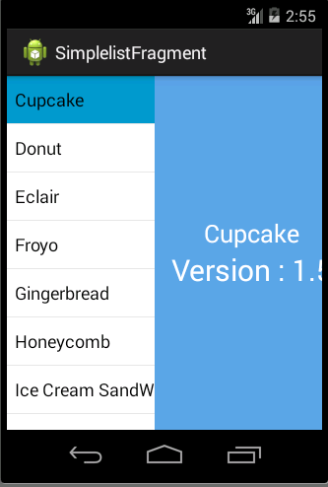
Example 2

Slide 27
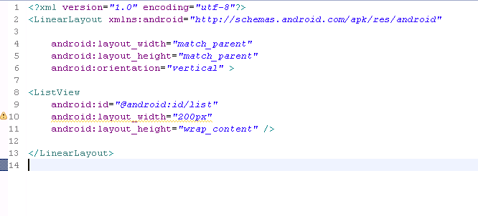
List_fragment.xml

Slide 28
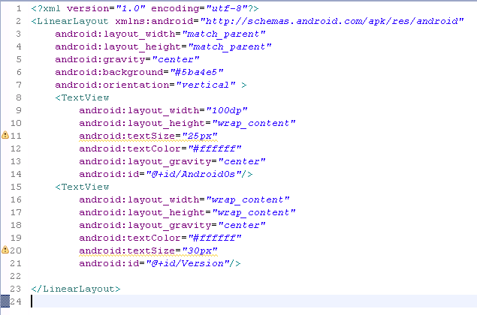
text_fragment.xml

Slide 29
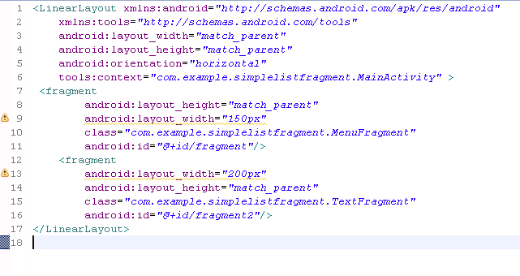
activity_main.xml

Slide 30
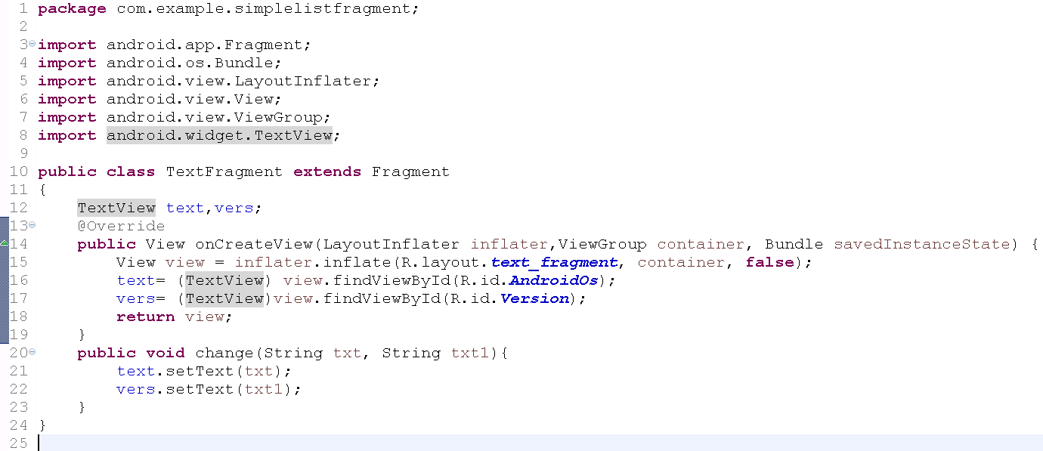
TextFragment.java

Slide 31
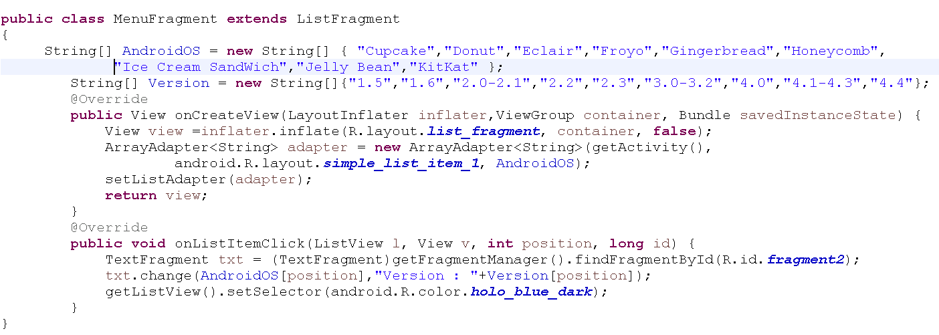
MenuFragment.java

Slide 32
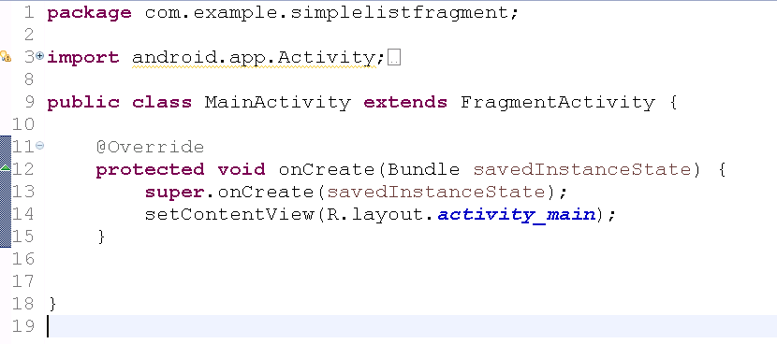
MainActivity.java

Slide 33
Using the Android Support Package
Fragments are so important to the future of the Android platform that the Android team provided a compatibility library so that developers can update their legacy applications as far back as Android 1.6, if they so choose
This library was originally called the Compatibility Package and is now called the Android Support Package

Slide 34
Adding Fragment Support to Legacy Applications
The choice of whether or not to update older applications is a personal one for the development team
Non-Fragment applications should continue to function for the foreseeable future without error, mostly due to the Android team’s continued policy of supporting legacy applications as much as possible when new platform versions are released

Slide 35
Adding Fragment Support to Legacy Applications
Here are some considerations for developers with legacy applications who are considering whether or not to revise their existing code:
  Leave your legacy application as is, and the ramifications are not catastrophic
  If your application has a lot of market traction and you’ve continued to update it as the Android platform has matured, you’re more likely to want to consider the Android Support Package
  Just because you start using the Android Support Package in your applications does not mean you have to implement every new feature (fragments, loaders, and so on) immediately
  Choosing to not update your code to new controls could leave your legacy application looking dated compared to other applications
Notes:
Leave your legacy application as is, and the ramifications are not catastrophic
Your application will not be using the latest and greatest features that the Android platform has to offer (and users will notice this), but it should continue to run as well as it always has without any additional work on your part. If you have no plans to update or upgrade your old applications, this may very well be a reasonable choice. The potentially inefficient use of screen space may be problematic but should not create new errors.
If your application has a lot of market traction and you’ve continued to update it as the Android platform has matured, you’re more likely to want to consider the Android Support Package
Your users may demand it. You can certainly continue to support your legacy application and create a separate new-and-improved version that uses the new platform features, but this means organizing and managing different source code branches and different application packages, and it complicates application publication and reporting, not to mention maintenance. Better to revise your existing application to use the Android Support Package and do your best to keep your single code base manageable. The size and resources of your organization may be contributing factors to the decision here.
Just because you start using the Android Support Package in your applications does not mean you have to implement every new feature (fragments, loaders, and so on) immediately
You can simply pick and choose the features that make the most sense for your application and add others over time via application updates when your team has the resources and inclination.
Choosing to not update your code to new controls could leave your legacy application looking dated compared to other applications
If your application is already completely customized and isn’t using stock controls—often the case with games and other highly graphical apps—it may not need updating. If, however, you conform to stock system controls, look, and feel, it may be more important for your application to get a fresh look.

Slide 36
Using Fragments in New Applications Targeting Older Platforms
Reasons why you should use fragments if you are starting to develop a new application
  Regardless of what devices and platforms you are targeting now, there will be new ones in the future that you cannot foresee
    Fragments give you the flexibility to easily adjust your user interface screen workflows without rewriting or retesting all your application code
  Incorporating the Android Support Package into your applications early means that if other important platform features are added later, you’ll easily be able to update the libraries and start using them
  By using the Android Support Package, your application will not show its age nearly as quickly since you will be incorporating the newer features of the platform and providing them to users on older platforms

Slide 37
Linking the Android Support Package to Your Project
To use the Android Support Package with your application, take the following steps:
  Use the Android SDK Manager to download the Android Support Package (formerly the Compatibility Package)
  Find your project in the Package Explorer or Project Explorer
  Right-click the project and choose Android Tools, Add Compatibility Library...
  The most updated library will be downloaded, and your project settings will be modified to use the newest library
  Begin using the APIs
    For example, to create a class extending FragmentActivity, import android.support.v4.app.FragmentActivity

Slide 38
Exploring Nested Fragments
A recent addition to Android 4.2 (API Level 17) is the ability to nest fragments within fragments
Nested fragments have also been added to the Android Support Library, making this API capability available all the way back to Android 1.6 (API Level 4)

Slide 39
Exploring Nested Fragments
In order to add a Fragment within another Fragment, you must invoke the Fragment method getChildFragmentManager(), which returns a FragmentManager
Once you have the FragmentManager, you can start a FragmentTransaction by calling beginTransaction() and then invoking the add() method, including the Fragment to add and its layout, followed by the commit() method

Slide 40
Exploring Nested Fragments
Nested fragments bring many possibilities for creating dynamic and reusable nested components
Some examples include
  Tabbed fragments within tabbed fragments
  Paging from one Fragment item/Fragment detail screen to a next Fragment item/Fragment detail screen with ViewPager
  Paging fragments with ViewPager within tabbed fragments
  Along with a host of many other use cases

